Slide 1
The MC LC model – an outline of a Structured Scientific Talk
This PPt template is an outline of a Structured Scientific Talk of about 10–30 minutes. It is based on chapter 16 in the book Designing
Science Presentations by Matt Carter, Assistant Professor of Biology
at Williams College, USA.
The template is produced by Olle Bergman (http://crastina.se). It is
intended to act as a starting point and the student is encouraged to
modify the structure according to his or her own material and taste.

Slide 2
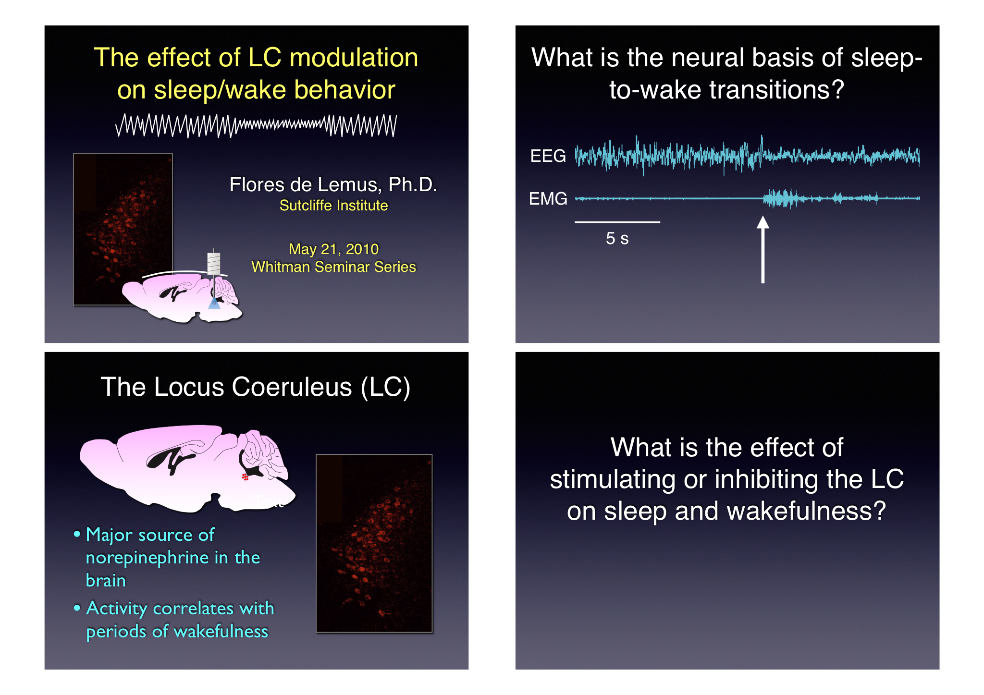

Slide 3
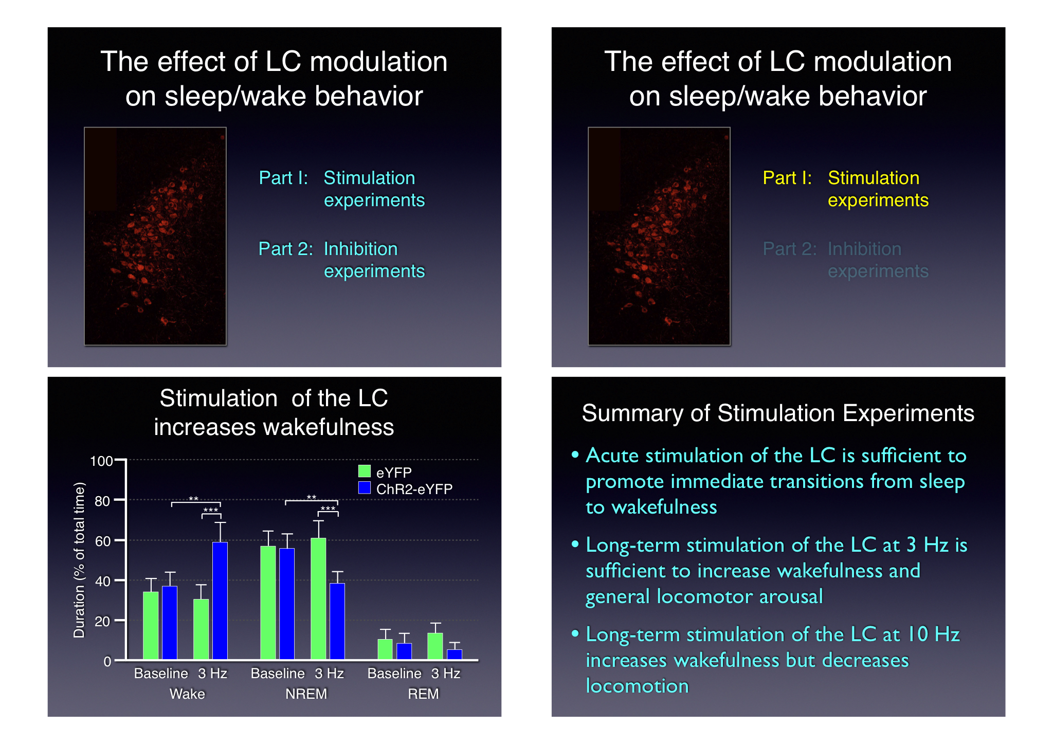

Slide 4
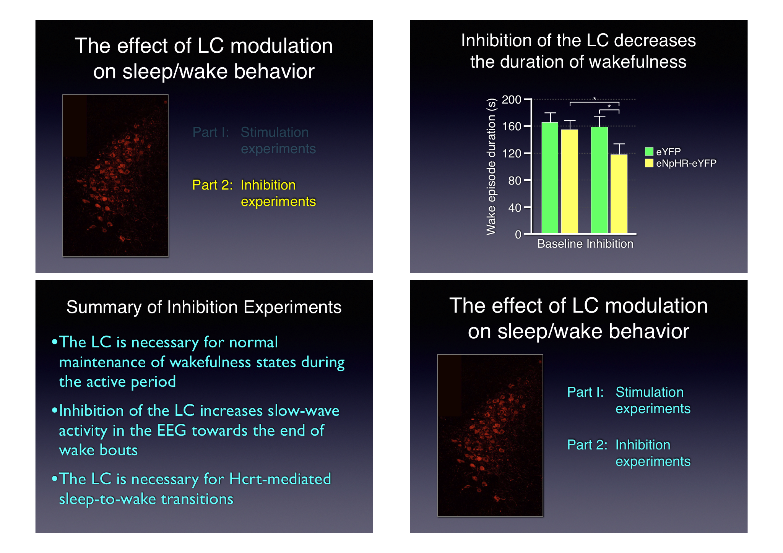

Slide 7
Title
Name & title
University
Event
Date

Slide 8
Broad question or topic

Slide 9
Background info
Explanation
Explanation
Explanation

Slide 10
Main question or goal

Slide 11
Home slide (part I)
Part 1: X experiments
Part II: Y experiments

Slide 12
Result experiment I
100
eYFP
ChR2-eYFP
80
**
**
***
***
60
Duration (% of total time)
40
20
0
Baseline
3 Hz
Baseline
3 Hz
Baseline
3 Hz
Wake
NREM
REM

Slide 13
Summary part 1
Results and observations
Results and observations
Results and observations
Results and observations

Slide 14
Home slide (part II)
Part 1: X experiments
Part II: Y experiments

Slide 15
Result experiment II
100
eYFP
ChR2-eYFP
80
**
**
***
***
60
Duration (% of total time)
40
20
0
Baseline
3 Hz
Baseline
3 Hz
Baseline
3 Hz
Wake
NREM
REM

Slide 16
Summary part 1I
Results and observations
Results and observations
Results and observations
Results and observations

Slide 17
Home slide
Part 1: X experiments
Part II: Y experiments

Slide 18
Conclusion: A is necessary for B.

Slide 19
Broad ending

Slide 20
Acknowledgements
People
People
People

Slide 21
Q&A slide with summary
Summarising sentence1
Summarising sentence 2
Summarising sentence 3

